Slide 1
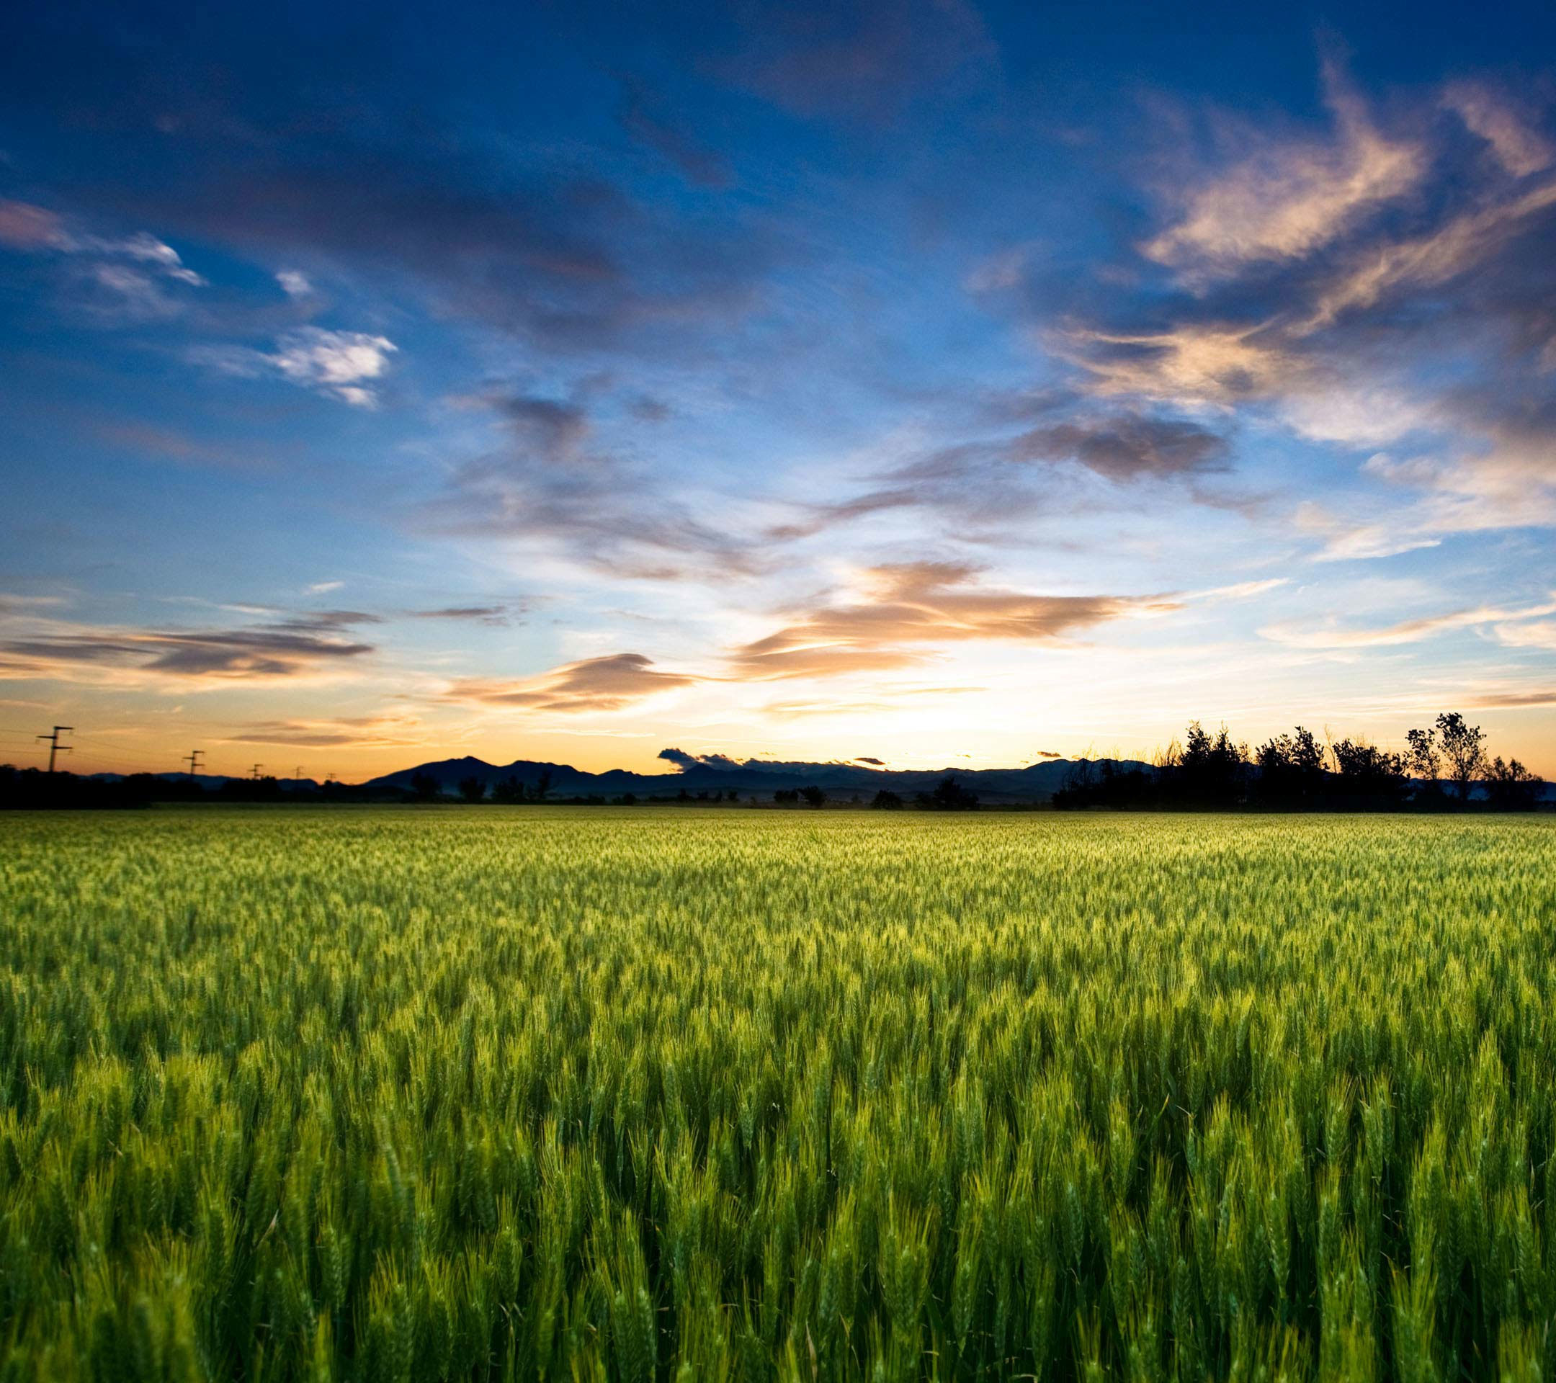
SMART AGRICULTURE SYSTEM
BASED ON IOT

Slide 2
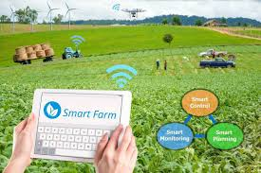
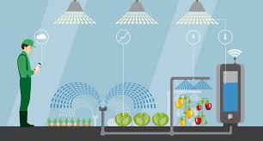
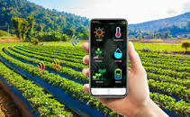
What is smart farming?
Smart farming is a technique used to improve the crop production using latest technolgy

Slide 3
Why smart farming?
To increase crop production
To decrease human efforts
To increase crop quality
To reduce Crop loses
To take preventive measures about weather changes

Slide 4
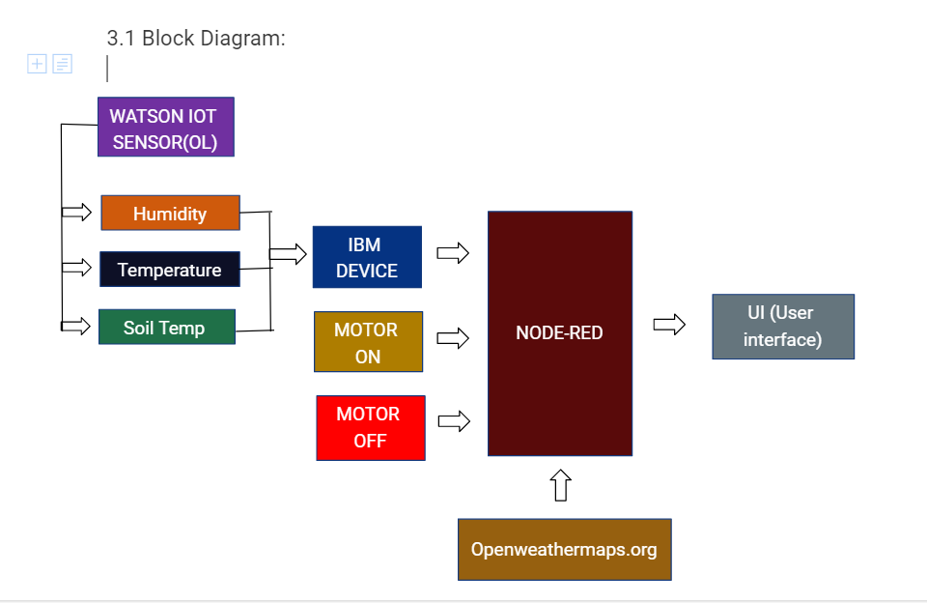

Slide 5
Conclusion:
Smart agriculture is really helpful to farmers and provides a great source to predict the upcoming weather forecast and prevent a lot of crop damage and loses and to reduce few human efforts of switching the motor.

